Slide 1
KID & CPN Website
Sunday, September 30, 2012

Slide 2
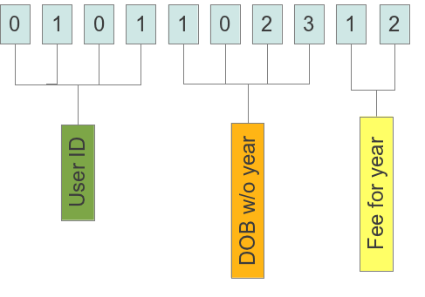
Payment ID / KID number
Why we need it?
How it is composed?
How you get it?
How to use it?

Slide 3
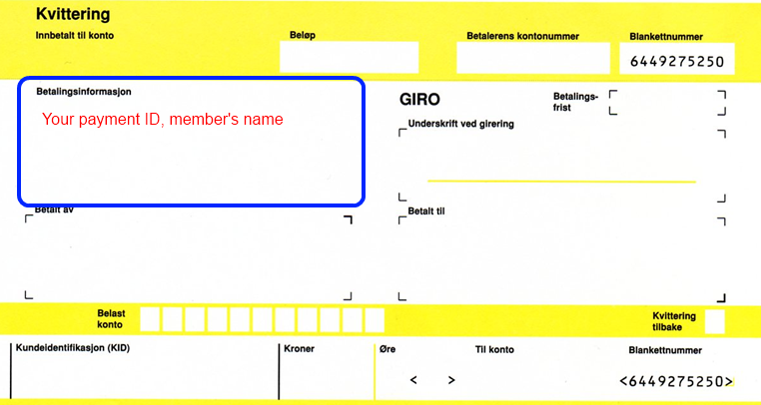
How to use Payment ID / KID number

Slide 4
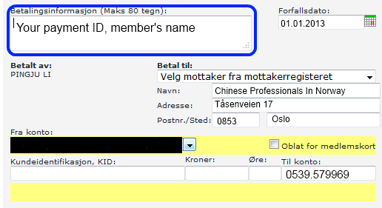
How to use Payment ID / KID number

Slide 5
Apply for support from Oslo Kommune
Kommune needs:
Full name
DOB
Address
The formation should be the same as registered in Folkeregisteret
Log into CPN2003.no to update your information

Slide 6
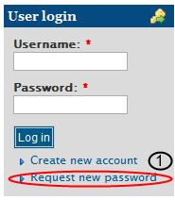
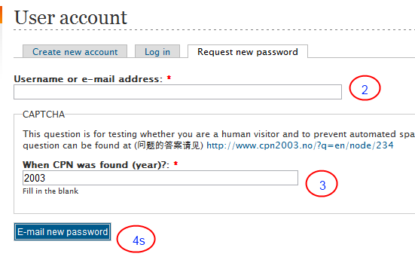
How to change password

Slide 7
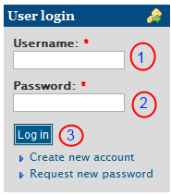
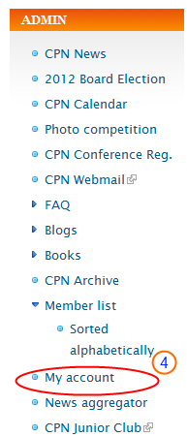
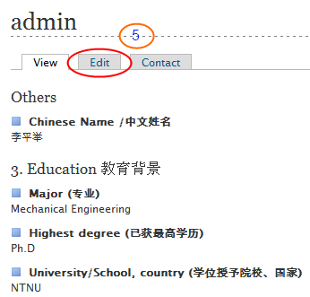
How to change your information

Slide 8
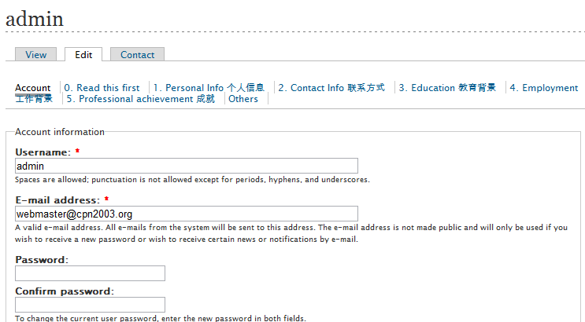
How to change your information

Slide 9
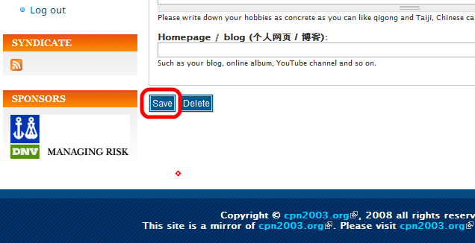
How to change your information

Slide 10
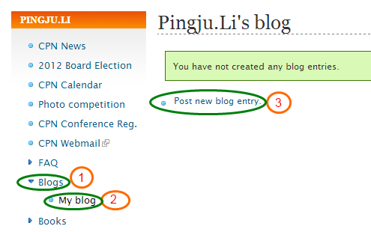
Your Blog

Slide 11
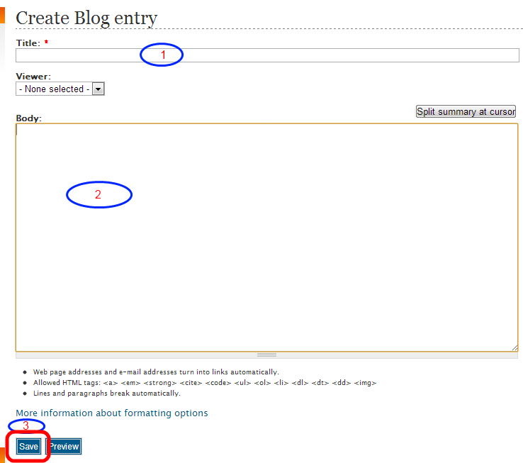
Your Blog

Slide 12
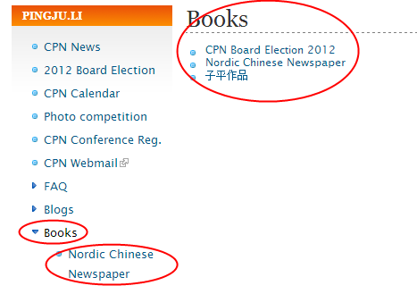
Your Book

Slide 13
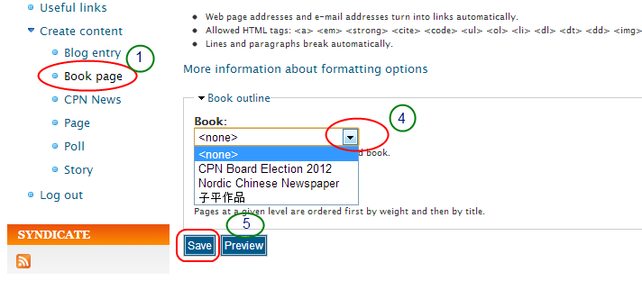
Your Book

Slide 14
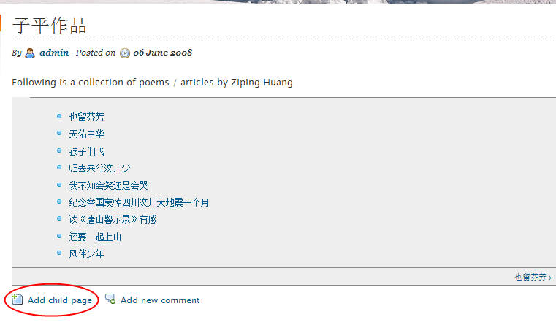
Your Book

Slide 15
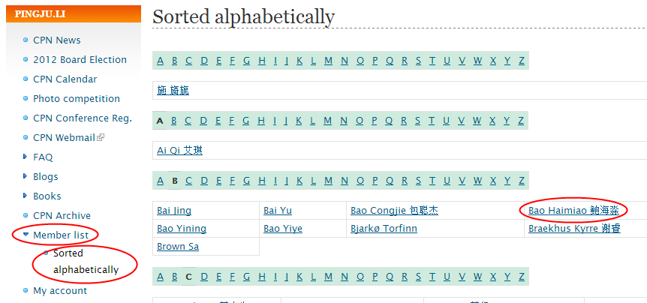
Member’s Profile

Slide 16
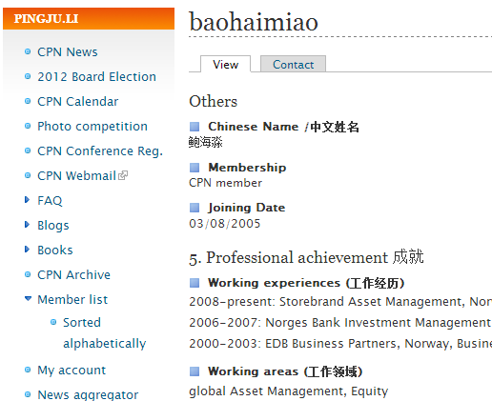
Member’s Profile

Slide 17
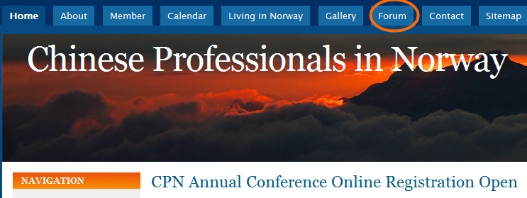
Other functions available

Slide 18
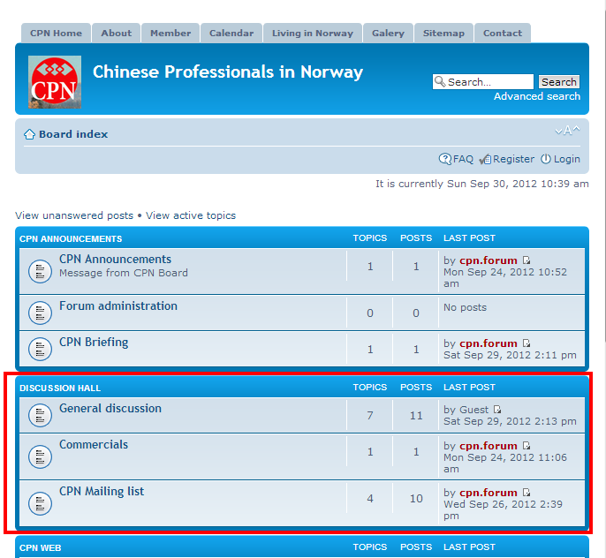
CPN Forum

Slide 19
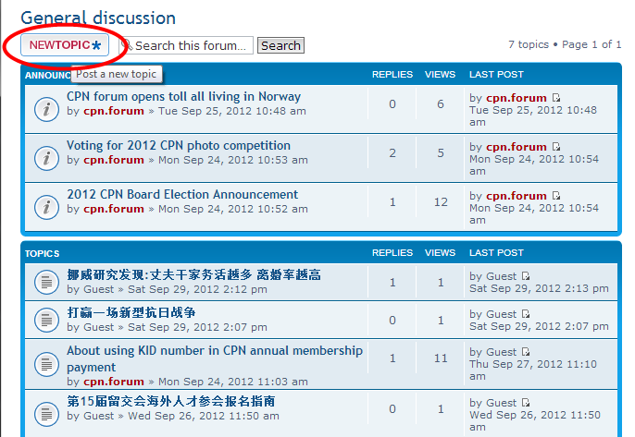
CPN Forum: New Topic

Slide 20
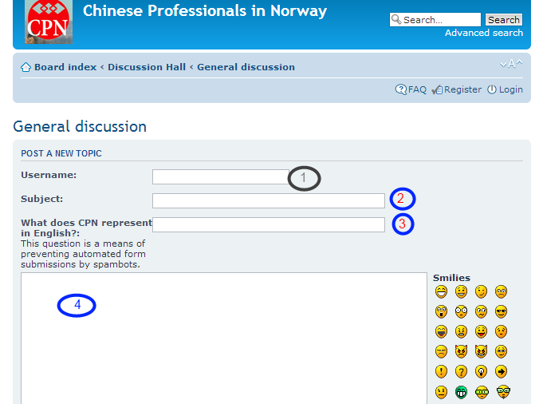
CPN Forum: New Topic

